Slide 1
Notes:
How I was able to formulate that introducton

Slide 3
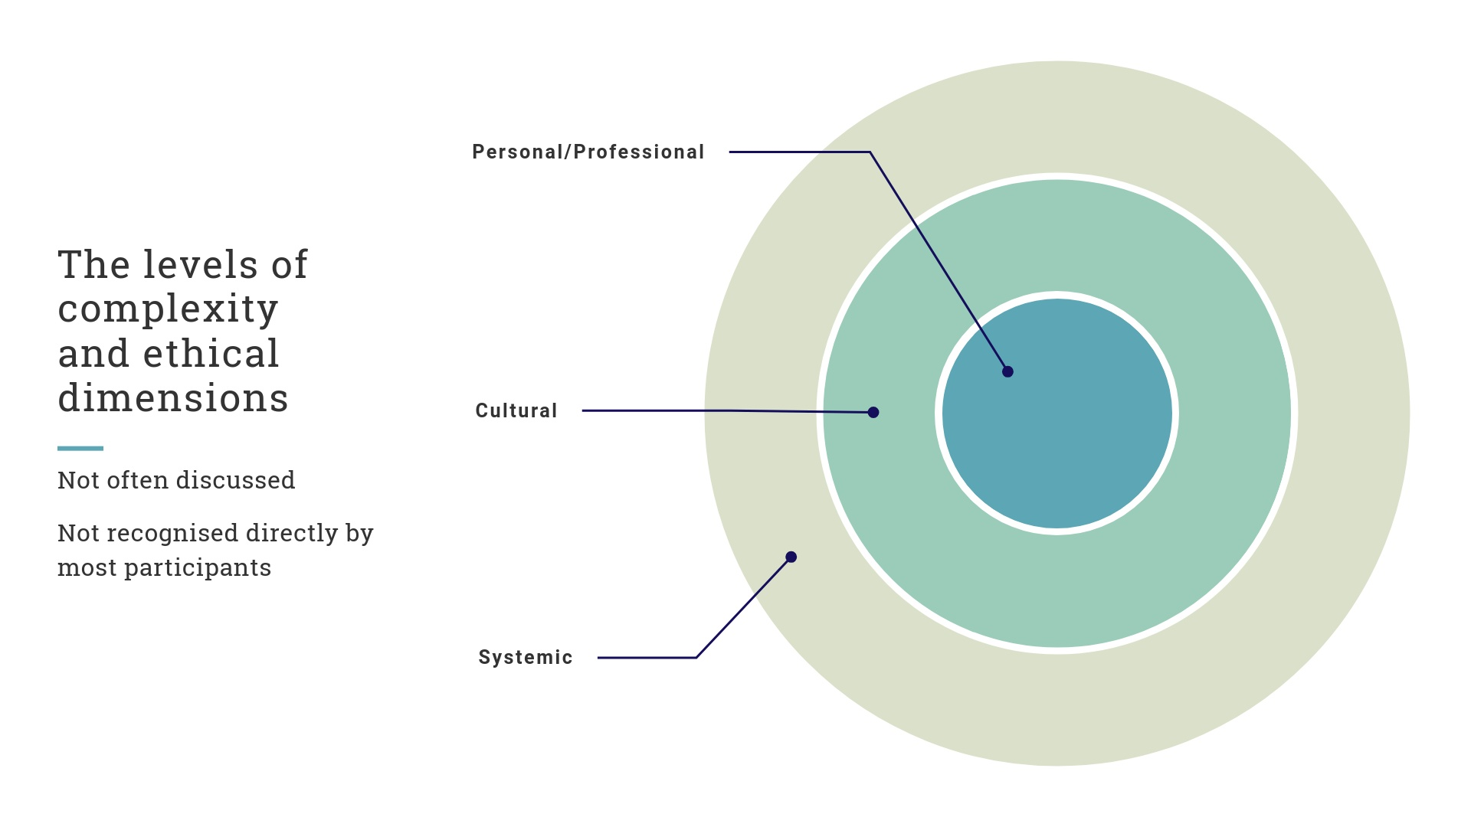

Slide 8
